Slide 1
Container Management
Members:
1.Shreyansh Dubey
2.Harshwardhan Mehrotra
3.Soham Dhandhe
4.Viren Ghuikhedkar

Slide 2
Problem Statements:
A vast number of containers can become too complex for an IT team to handle.So Container management will use software to automatically create, deploy and scale containers so as to make the work easier to handle.
Container management is necessary when enterprises rely on containers to quickly deploy and update applications

Slide 3
Uses
Pull Images easily
Deployment of containers.
Management of containers.

Slide 4
Social Aspects:
Will improve work for IT team to smoothen up the container handling.
Will Increase portability,more consistent operation greater efficiency.

Slide 5
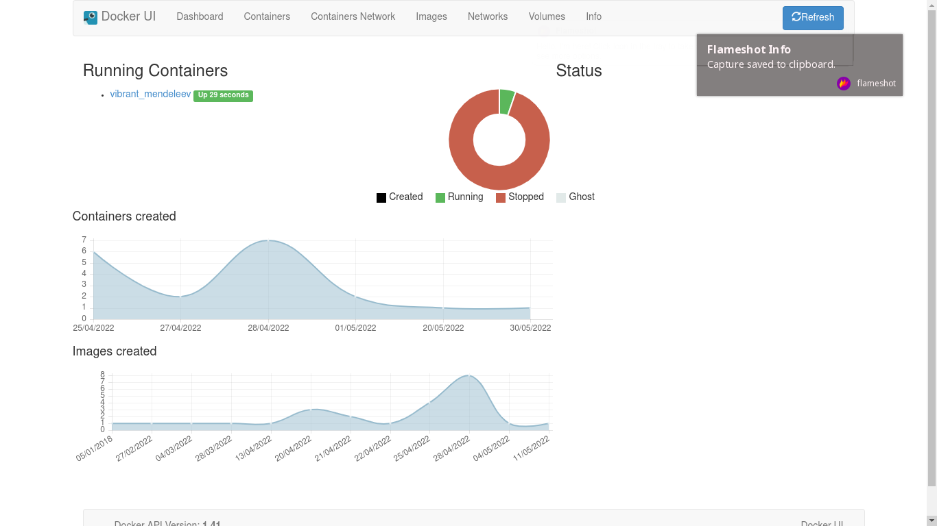
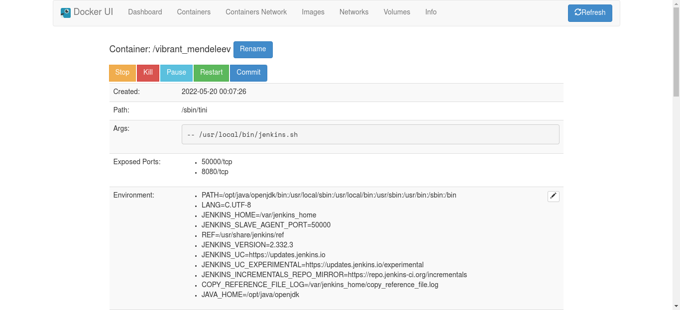
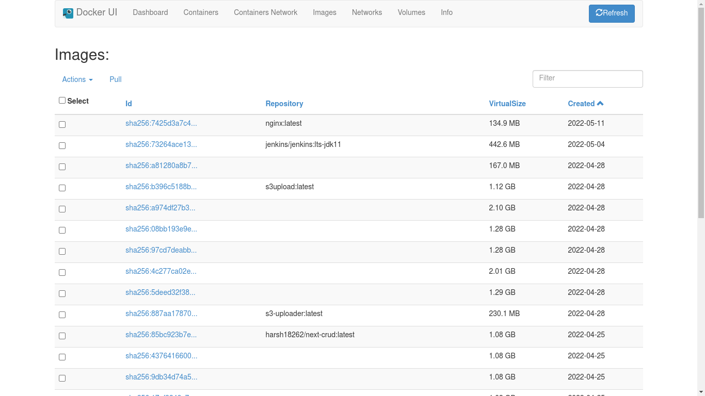
Output

Slide 6
Program Code
https://github.com/harsh18262/Container_management_system.git

Slide 7
Demonstration

Slide 8
Conclusion

Slide 9
Future Aspect Of Project
Add a feature to create a container from the webui
Auto update images
Auto update containers
Create Container stacks
Add Login Page
Create this app as a bastion server

Slide 10
Thank You

